Slide 1
MACHINE LEARNING

Slide 2
USED TECHNIQUES
Logistic Regression
Linear model
Neural Networks
Interconnected layers of neurons
Map data for a desired output
Random Forest
Builds multiple decisión trees
Used in classification and regression tasks
Binary Classification
Used for binary and non-binary data
Inputs > Act. Function > Outputs

Slide 3
LOGISTIC REGRESSION *JUPYTER NOTEBOOK

Slide 4
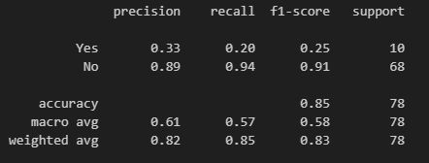
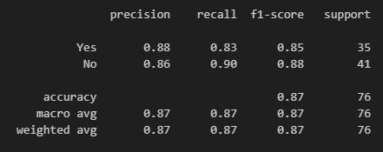
LOGISTIC REGRESSION Confusion matrix
Lung Cancer
Heart Attack
True Positives (Yes are actual Yes):
2/10 correctly identified.
False Negatives (No are actual Yes):
8 lung cases missed.
True Negatives (No are actual No):
64/68 correctly identified.
False Positives(Yes are actual No):
4 cases incorrectly classified.
True Positives (Yes are actual Yes):
29/35 cases correctly identified.
False Negatives (No are actual Yes):
6 cases were missed
True Negatives (No are actual No):
37/41 cases correctly identified
False Positives(Yes are actual No):
4 cases incorrectly classified

Slide 5
Used parameters
ACTIVATION FUNCTIONS
OPTIMIZERS
ReLU: Simple and efficient. Activates only positive inputs.
Leaky ReLU: A modified ReLU that allows a small, non-zero gradient for negative inputs.
ELU: Unlike ReLU, ELU allows negative inputs, helping to make the mean activations closer to zero
PReLU: A variant of Leaky ReLU, but with the slope of the negative part of the function being a learnable parameter
Swish: A smooth, non-monotonic function that outperforms ReLU in certain deep networks. Swish allows for small negative inputs
Adam: Widely used, computes individual rates for each parameter.
Adamax: More stable versión of Adam.
RMSprop: handles non-stationary objectives.
SGD: Gradient descent updating weights by the loss function.

Slide 6
Neural networks *JUPYTER NOTEBOOK

Slide 7
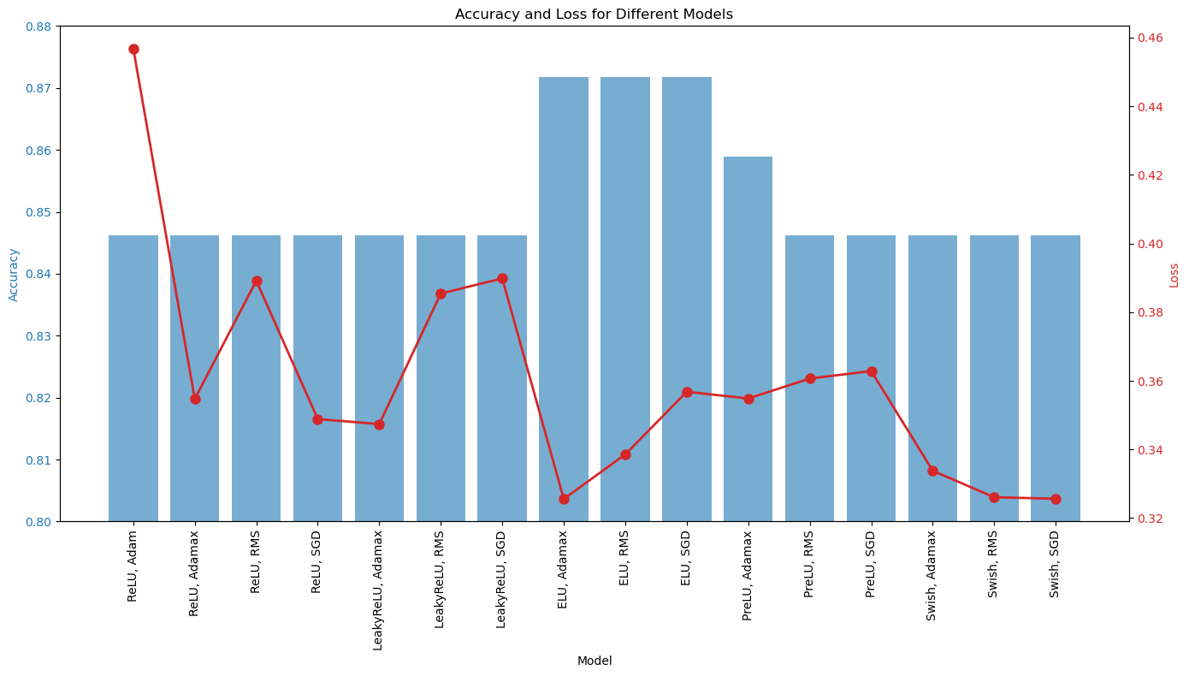
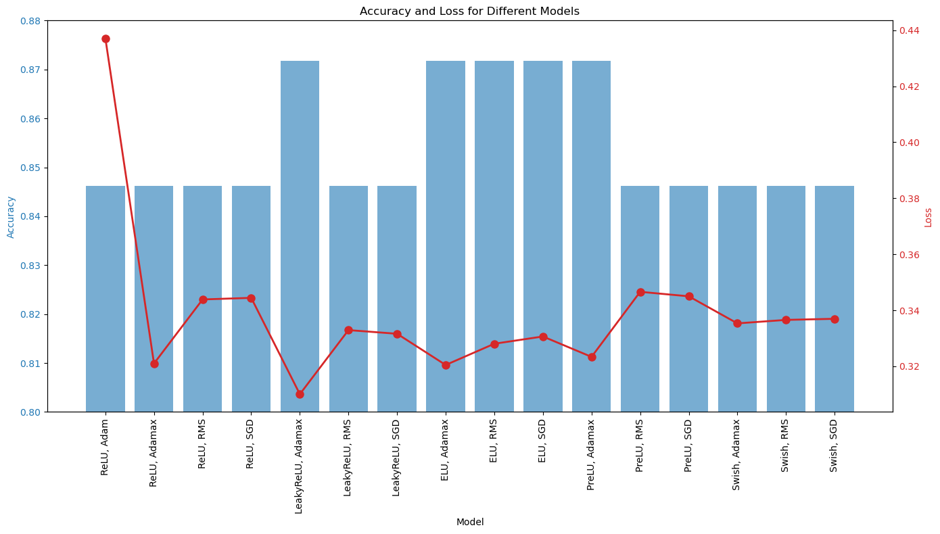
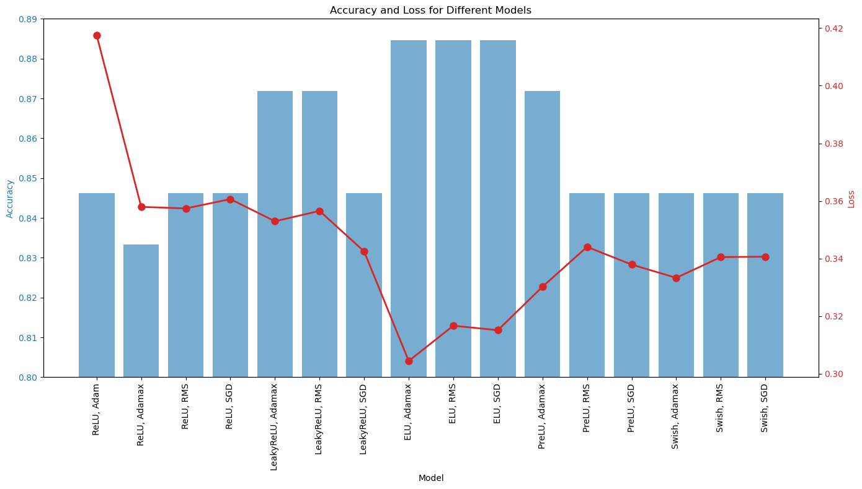
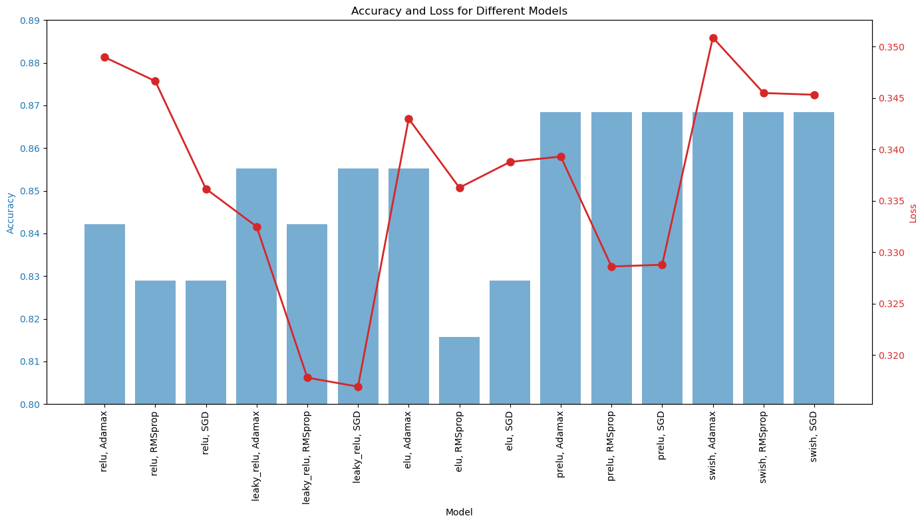
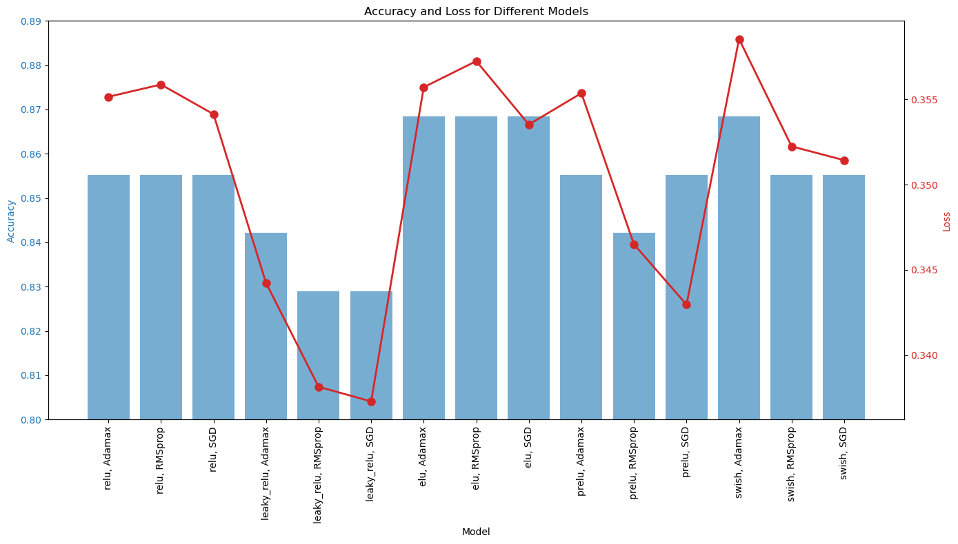
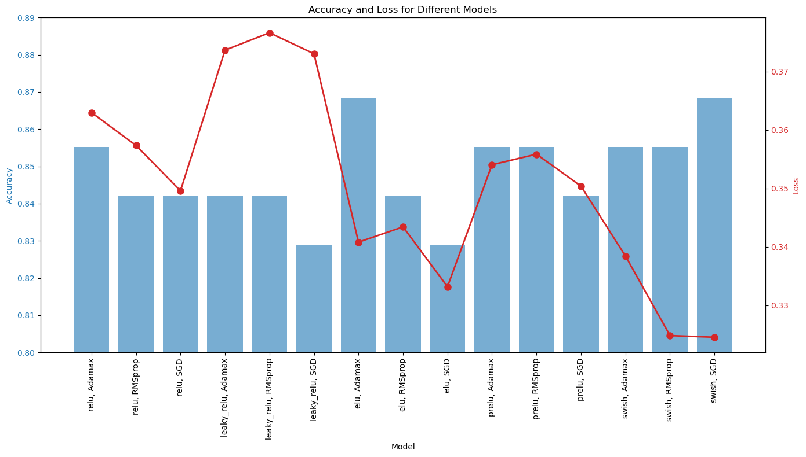
Lung cancer (elu, aDAMAX)
Heart attack (PRELU, SGD)***

